Slide 1
Murach’s PHP and MySQL (4th Edition)
Chapter 23
An eCommerce website

Slide 2
Objectives
Applied
Use the skills and applications presented in this book to develop your own websites, including eCommerce websites.
Knowledge
Describe the use of prototyping and stepwise refinement.
In general terms, describe the directory structure for a website.

Slide 3
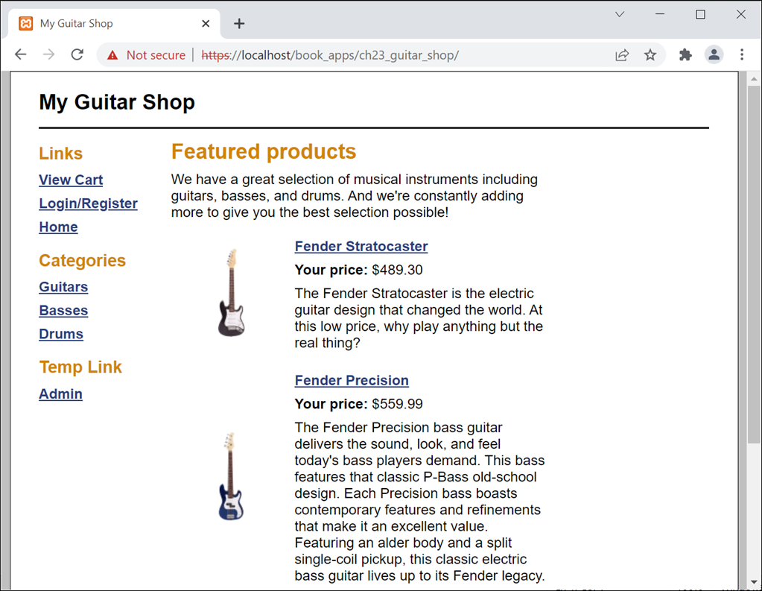
The Home page for the Guitar Shop prototype

Slide 4
Benefits of prototyping
You detect problems early in the development cycle when they cost less to fix.
Users are more likely to be satisfied by the final version of the website because they have participated in the development process.
Key terms related to prototyping
prototype
stepwise refinement
prototyping

Slide 5
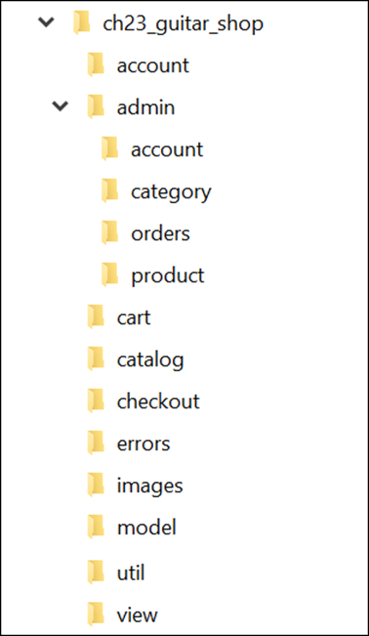
The directory structure of the website

Slide 6
The files in the application root directory
home_view.php
index.php
main.css

Slide 7
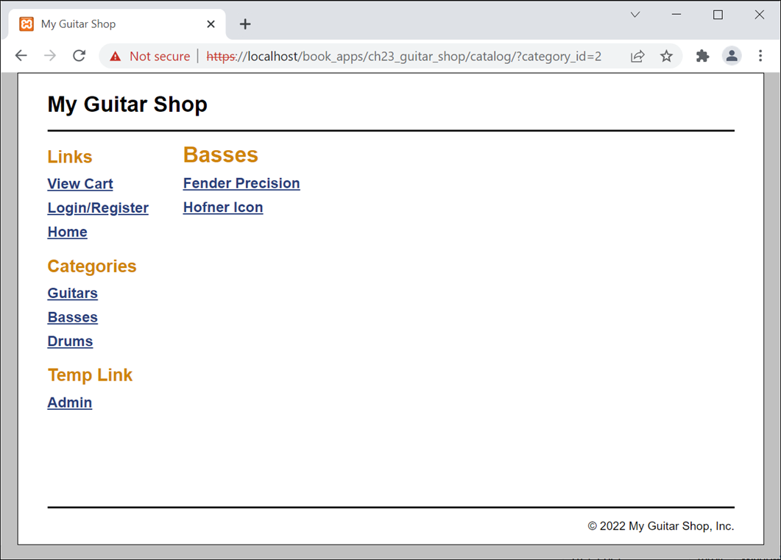
The catalog/category_view.php page

Slide 8
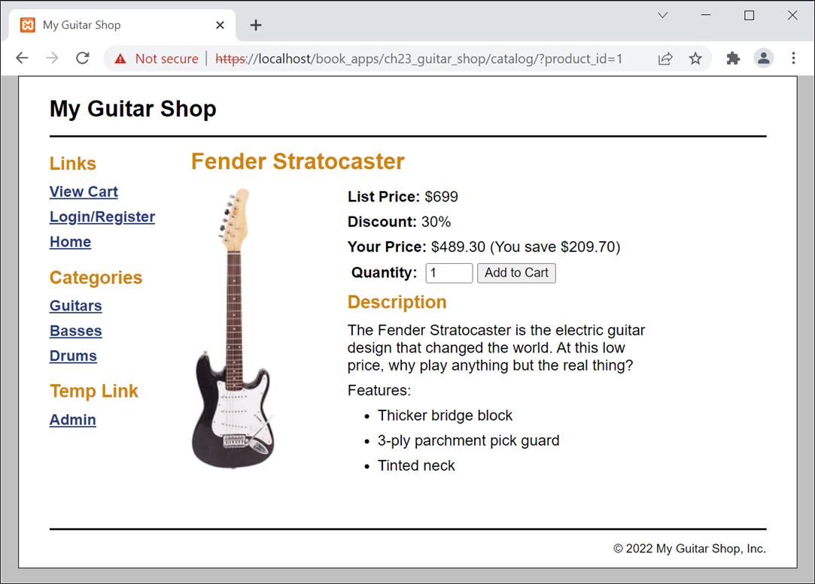
The catalog/product_view.php page

Slide 9
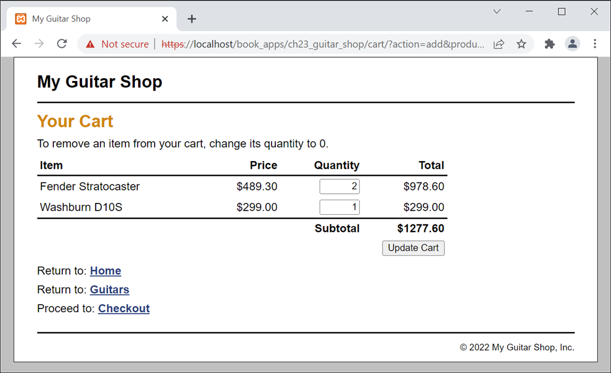
The cart/cart_view.php page

Slide 10
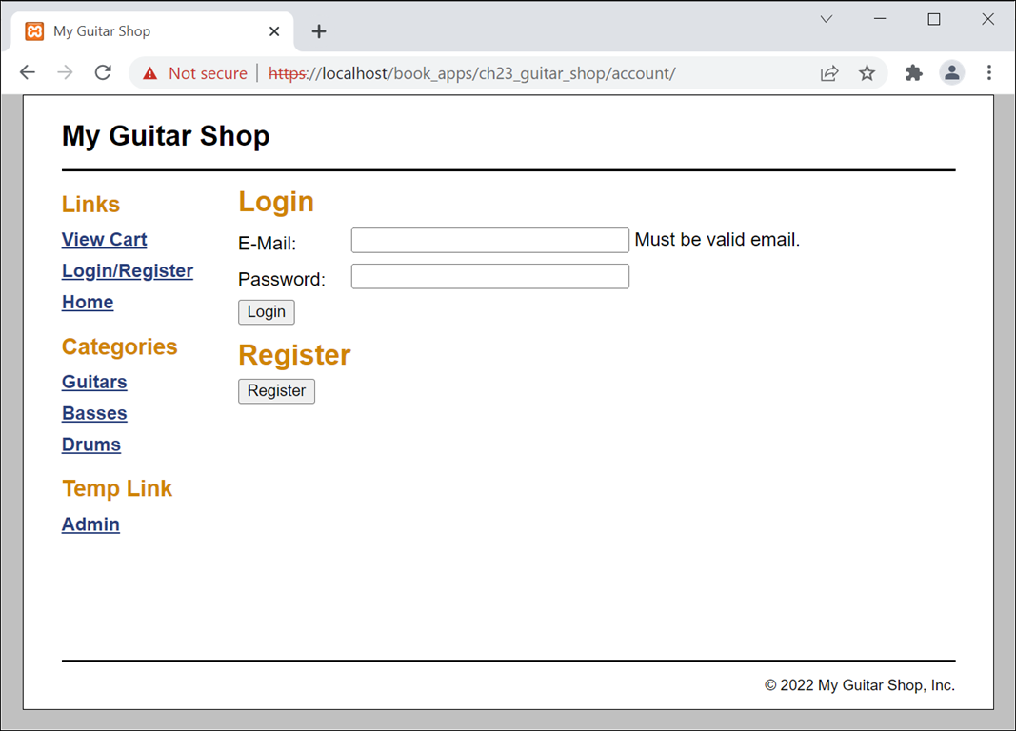
The account/account_login_register.php page

Slide 11
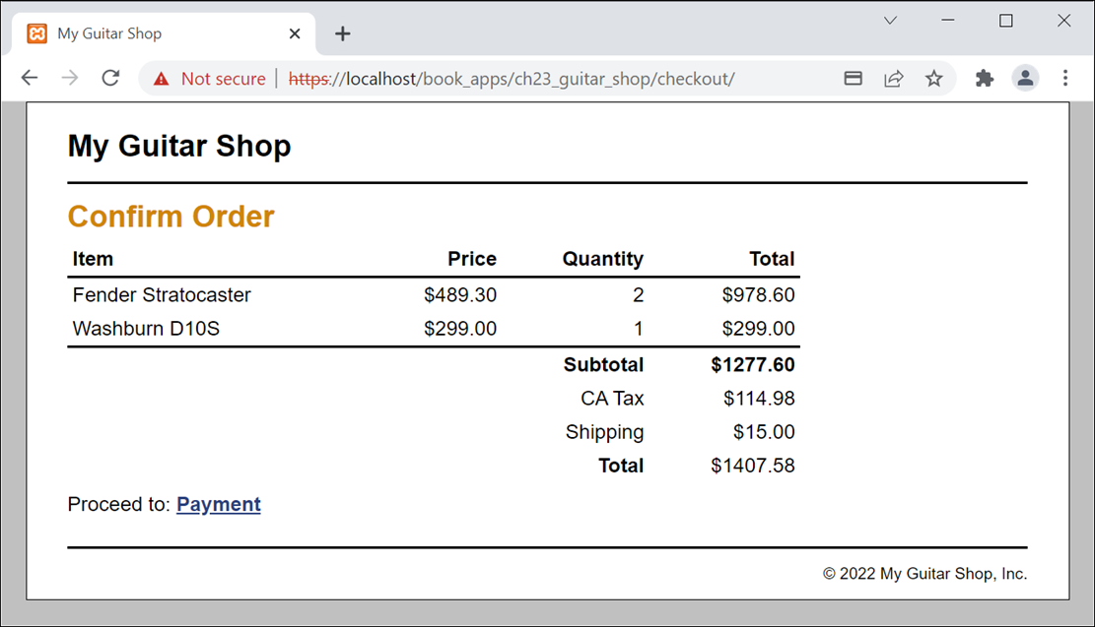
The checkout/checkout_confirm.php page

Slide 12
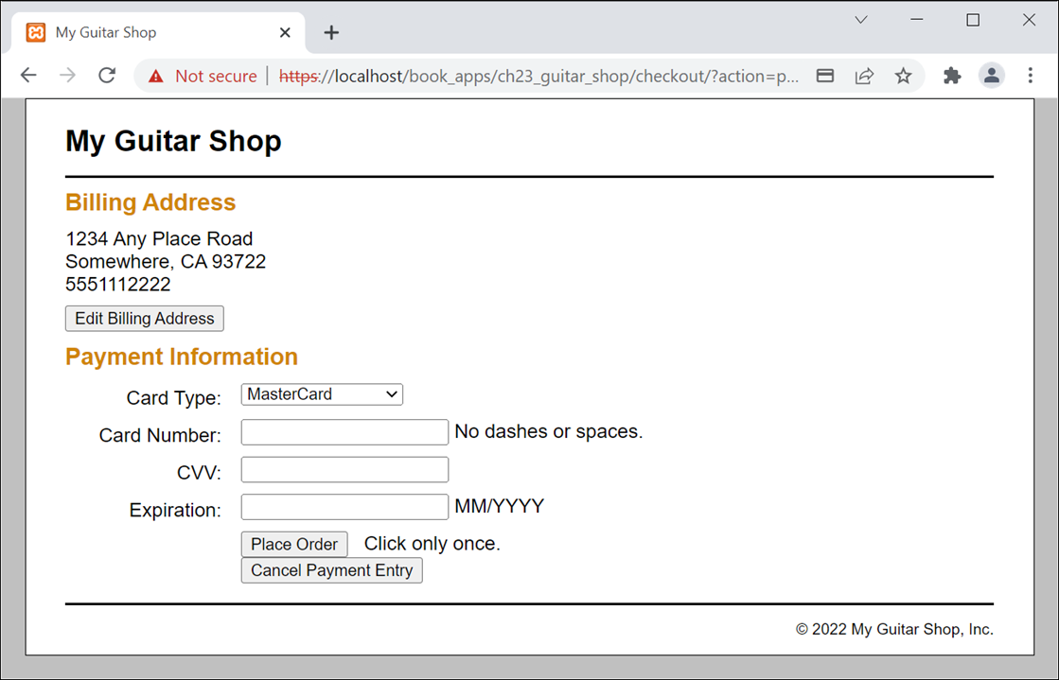
The checkout/checkout_payment.php page

Slide 13
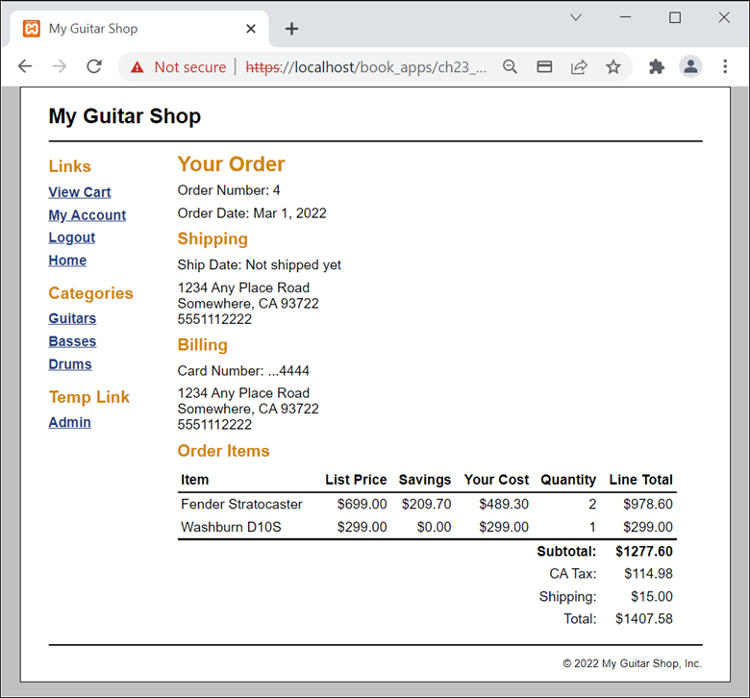
The account/account_view_order.php page

Slide 14
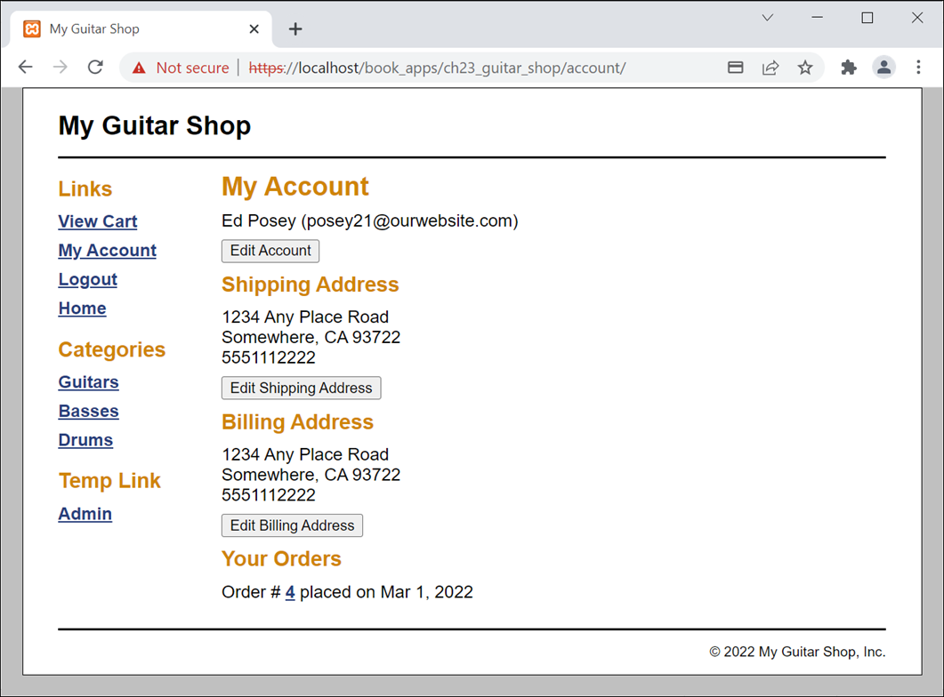
The account/account_view.php page

Slide 15
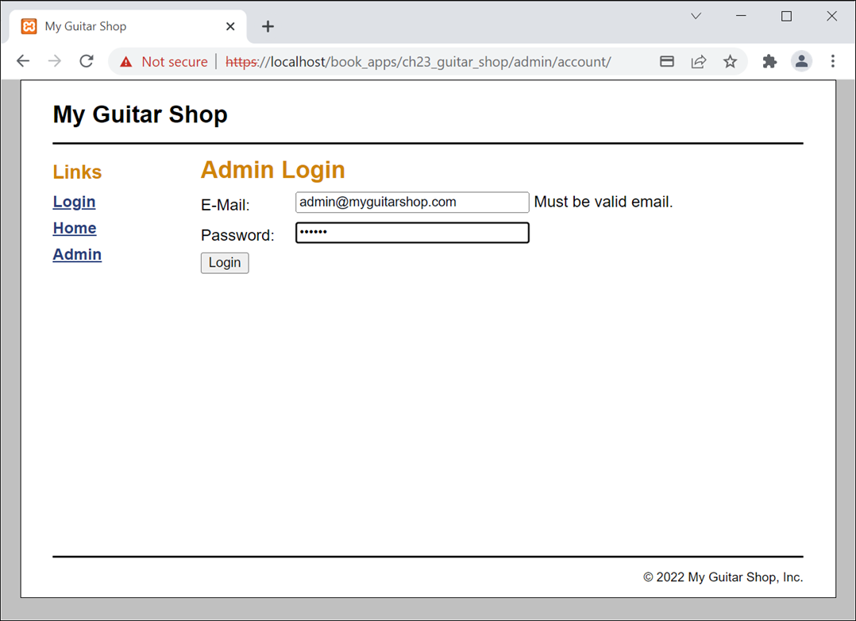
The admin/account/account_login.php page

Slide 16
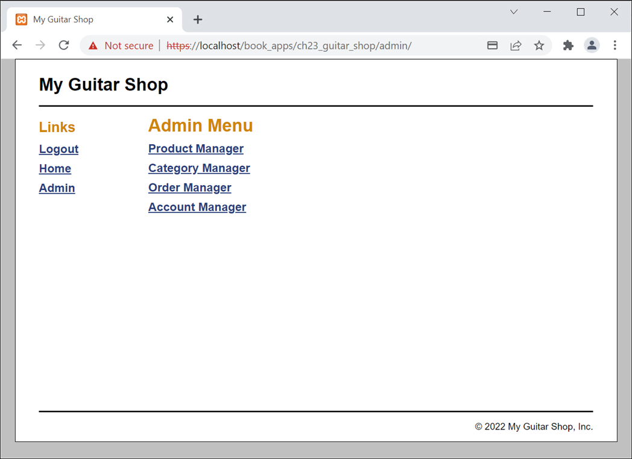
The admin/index.php page

Slide 17
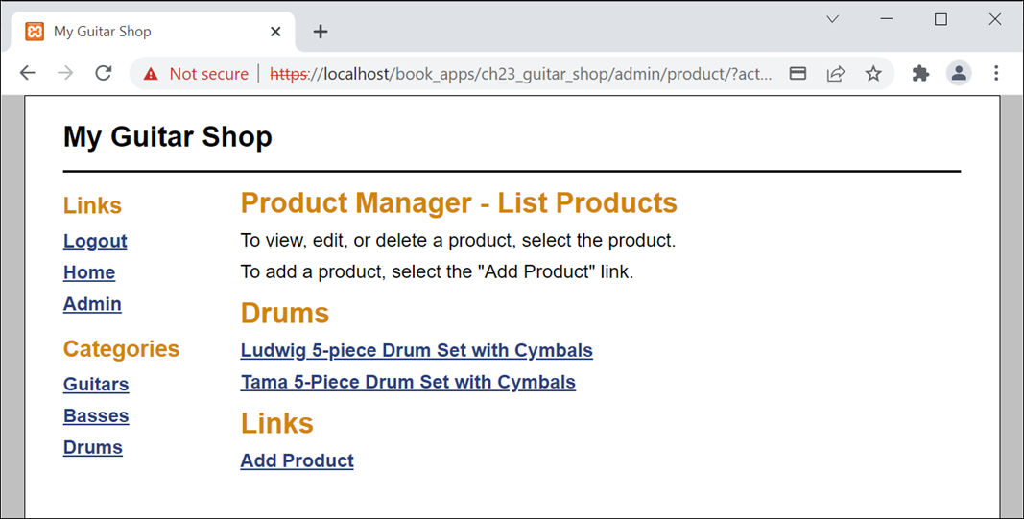
The admin/product/product_list.php page

Slide 18
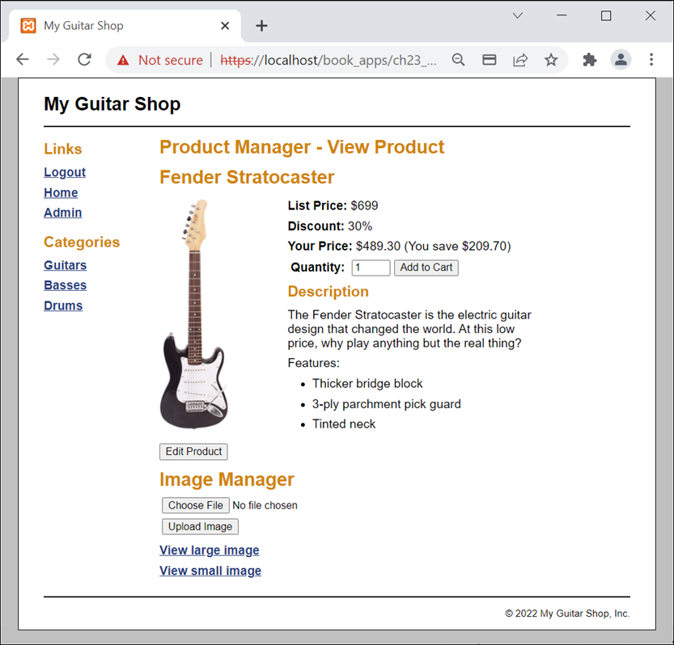
The admin/product/product_view.php page

Slide 19
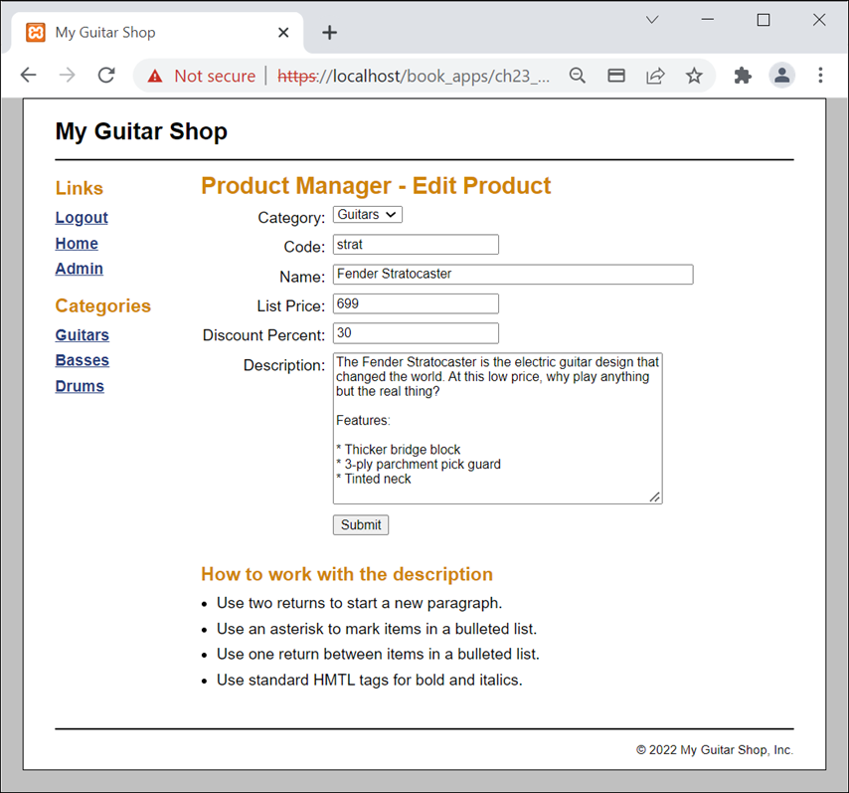
The admin/product/product_add_edit.php page

Slide 20
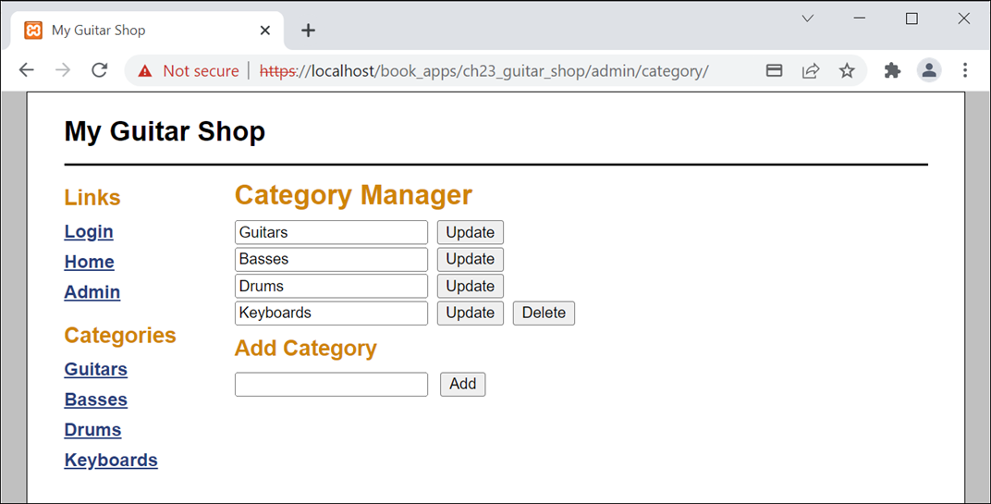
The admin/category/category_list.php page

Slide 21
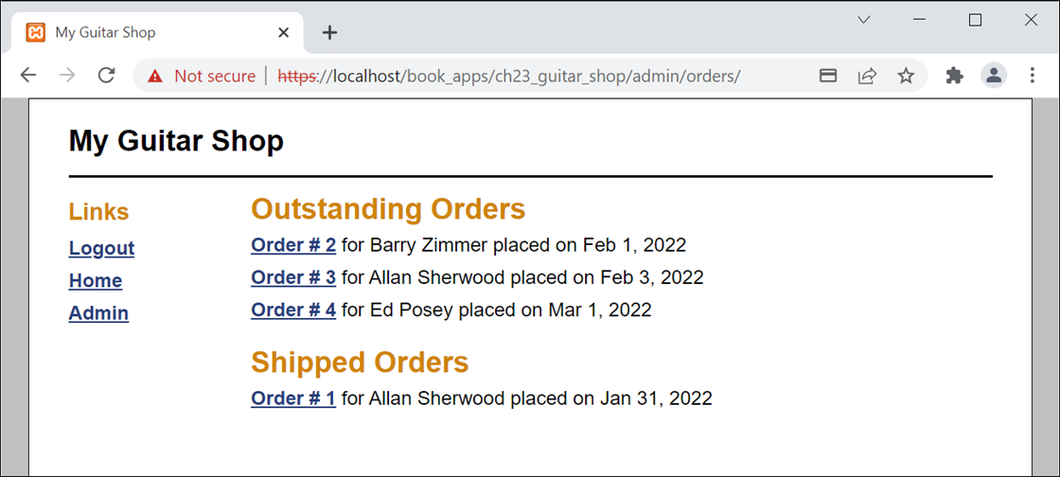
The admin/orders/orders.php page

Slide 22
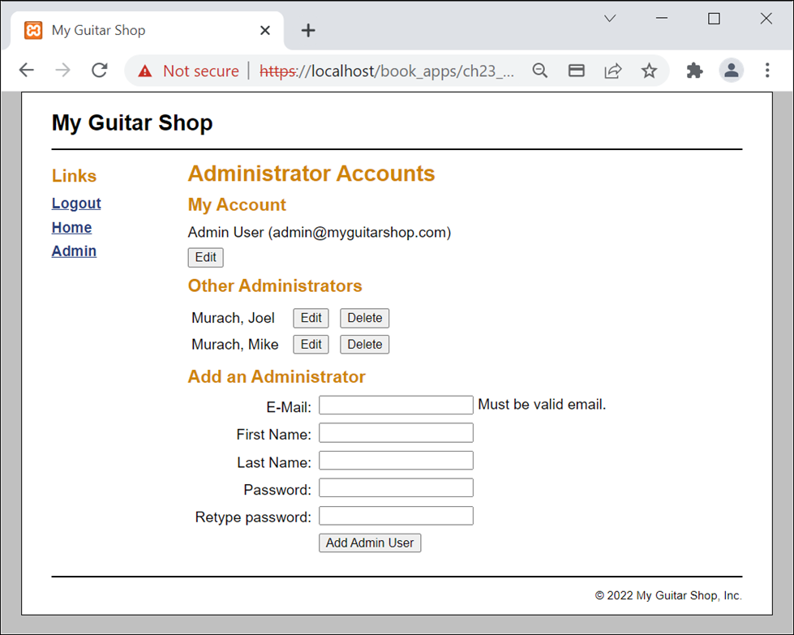
The admin/account/account_view.php page

